Slide 1
MSA Career Research
Chase Career Center | MSA BootCamp

Slide 2
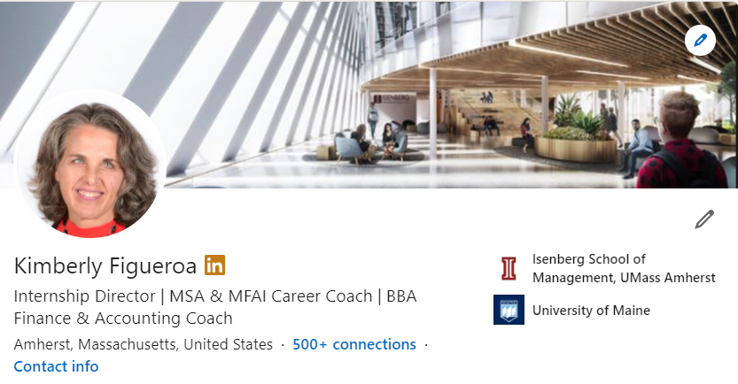
Your Career Coach
Email: kfigueroa@isenberg.umass.edu
Make An Appointment: https://bit.ly/3fYtbSA

Slide 3
Wait, what? I thought I was here to earn a degree!
6 reasons WHY Career Research
Provides Context for the work you do in class or new things (terms, job titles, companies, technologies, etc) you learn about
KEYWORDS!
Increases your understanding of career options (where can I go from here?) and career-pathing (entry level + beyond….)
Takes your career coaching conversations to the NEXT LEVEL
Encourages networking and informational interviewing
Starts to build the foundation for strong recruiting success AND avoids the last minute prep!

Slide 4
EX: I just read about a position called “Compliance Officer”…what’s that?
POSSIBLE RESEARCH STRATEGY
In LinkedIn
1. Search “Compliance Officer” in search bar, check out what you find
2. Look for Isenberg Alums with this title
3. Find anyone you’d like to connect with for an informational interview?
4. Search in “Jobs” for “Compliance Officer”
What are the qualifications?
What is the required experience?
What are the KEYWORDS associated with skills, certifications, education?
Google it!
Read Investopedia Definition
Check out the Job Description (The Balance Careers)
Think….???? Where else can I look?
Of course! LINKEDIN!

Slide 5
What we’ll cover
On Campus Recruiting (OCR)
CPD Plan (in brief)…more in the Q&A Cafe
Strategies for researching careers, job postings, requirements, salary information
Resources for career and industry research

Slide 6
OCR = “Right In Front of You” Opportunity
On-Campus Recruiting (OCR) is a recruiting method used by employers seeking to hire interns and entry-level employees from some of the brightest and most talented college students.
Each year, employers recruit on campus through: On-campus recruiting, Career fairs and networking events.
It’s the ONLY time in your life when employers are coming to a location seeking YOU specifically!
Understanding On-Campus Recruiting (OCR)

Slide 7
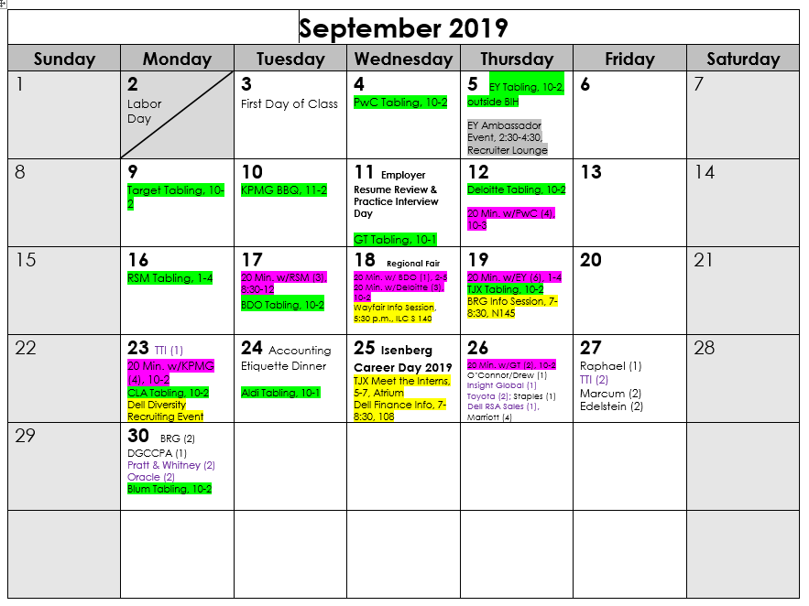
SEPTEMBER = LOTS of Activites!
Planned each semester with Chase Career Center and all firms present
Firm Specific Events
TABLING
20 Minutes With Events
Beta Alpha Psi Meetings
Accounting Career Fair
On Campus (or virtual) Interviews
Notes:
Let’s move into the different components of the OCR process.
I am showing you an example of the calendar that I will send out to students prior to the start of the semester. This is just the first page. You will receive this in an email that includes content about each of these items, what they mean and how you participate. I will also put the Fall 2020 Calendar in Blackboard when it has been created.
As you can see, the first few weeks of the semester are very busy! Chase plans this calendar during the prior semester (so, Spring!) with recruiters from the BIG 4 + RSM and Grant Thornton. It is helpful to have everyone at in the conversation during this planning so all the firms knows what each other is doing. This calendar is shared with the recruiters and with students.
You might wonder why the firms come to campus so frequently. The bottom line is “FACE TIME”. They want to get to know you. Your success in this process depends on how much time you can devote to being on campus and participating in these activities.
Tabling is the most accessible and informal activity as it is simply meeting with firm representatives at tables in the Isenberg Learning Commons area of the Innovation Hub.
“20 Minutes With” events require that you sign up through IsenbergWorks for a 20 minute, one on one meeting with a firm representative in one of our interview rooms in the Chase Career Center. These opportunities allow students to ask questions about almost anything regarding the process, the opportunities, resume feedback, etc.
BAP meetings (or Beta Alpha Psi, the finance and accounting professional organization) are open to all students. Membership in the organization is not required. These are attended by a lot of students and firms provide information about recruiting, practice areas, industry specialties, and other helpful firm related material.
All of these activities are designed to increase your knowledge of the firms and develop a rapport with the representatives. I consider each activity a unique “impression making” opportunity. Leveraged to the fullest, you can advance your conversation about your fit and interest with each successive touch point.
If you are living at a distance, you will need to be strategic about when you want to come to campus and how many activities you can participate in. For some of you who are working full time, it may only be possible to come for a BAP meeting in the evening. For some, it may be impossible to come to any.
Regional firms only come to campus for one special event exclusive to their cohort. This event allows them to meet with students away from the “distraction” of the larger firms. These firms represent the “120” group we spoke of earlier. I strongly encourage you to, at a minimum, consider these opportunities and if you can, attend this event.
You will also see that interviews with some of the regional firms start at the end of September. The majority of interviews will begin in the first week of October, but some of the regional players want to get out ahead of the Big firm interviews. This DOES mean that if you interview with one of these smaller firms, you MAY have an offer – and an acceptance deadline – sooner than or during first rounds with the larger firms.
The Isenberg Career Day is the last opportunity for students to interact with the larger firms…..by this time, you may have applied to the firm opportunities an are awaiting notification about being selected for an interview. If you can come to the fair, having a positive interaction with them for one last time could have a positive impact.
You will notice that I have indicated “virtual interviews” in point 8. In the next slide, I will talk more about this.

Slide 8
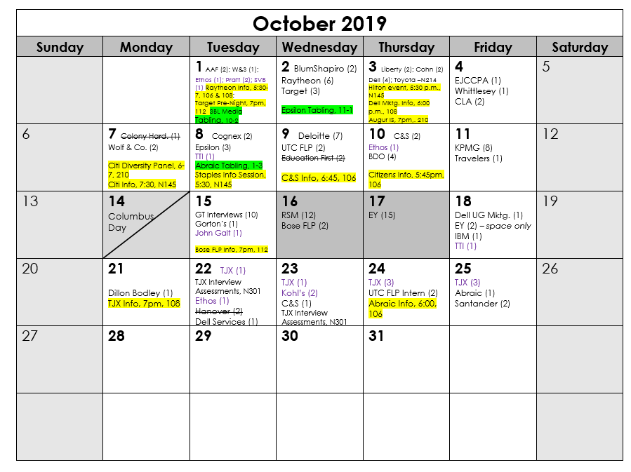
OCTOBER = Interviews
Notes:
Let’s move into the different components of the OCR process.
I am showing you an example of the calendar that I will send out to students prior to the start of the semester. This is just the first page. You will receive this in an email that includes content about each of these items, what they mean and how you participate. I will also put the Fall 2020 Calendar in Blackboard when it has been created.
As you can see, the first few weeks of the semester are very busy! Chase plans this calendar during the prior semester (so, Spring!) with recruiters from the BIG 4 + RSM and Grant Thornton. It is helpful to have everyone at in the conversation during this planning so all the firms knows what each other is doing. This calendar is shared with the recruiters and with students.
You might wonder why the firms come to campus so frequently. The bottom line is “FACE TIME”. They want to get to know you. Your success in this process depends on how much time you can devote to being on campus and participating in these activities.
Tabling is the most accessible and informal activity as it is simply meeting with firm representatives at tables in the Isenberg Learning Commons area of the Innovation Hub.
“20 Minutes With” events require that you sign up through IsenbergWorks for a 20 minute, one on one meeting with a firm representative in one of our interview rooms in the Chase Career Center. These opportunities allow students to ask questions about almost anything regarding the process, the opportunities, resume feedback, etc.
BAP meetings (or Beta Alpha Psi, the finance and accounting professional organization) are open to all students. Membership in the organization is not required. These are attended by a lot of students and firms provide information about recruiting, practice areas, industry specialties, and other helpful firm related material.
All of these activities are designed to increase your knowledge of the firms and develop a rapport with the representatives. I consider each activity a unique “impression making” opportunity. Leveraged to the fullest, you can advance your conversation about your fit and interest with each successive touch point.
If you are living at a distance, you will need to be strategic about when you want to come to campus and how many activities you can participate in. For some of you who are working full time, it may only be possible to come for a BAP meeting in the evening. For some, it may be impossible to come to any.
Regional firms only come to campus for one special event exclusive to their cohort. This event allows them to meet with students away from the “distraction” of the larger firms. These firms represent the “120” group we spoke of earlier. I strongly encourage you to, at a minimum, consider these opportunities and if you can, attend this event.
You will also see that interviews with some of the regional firms start at the end of September. The majority of interviews will begin in the first week of October, but some of the regional players want to get out ahead of the Big firm interviews. This DOES mean that if you interview with one of these smaller firms, you MAY have an offer – and an acceptance deadline – sooner than or during first rounds with the larger firms.
The Isenberg Career Day is the last opportunity for students to interact with the larger firms…..by this time, you may have applied to the firm opportunities an are awaiting notification about being selected for an interview. If you can come to the fair, having a positive interaction with them for one last time could have a positive impact.
You will notice that I have indicated “virtual interviews” in point 8. In the next slide, I will talk more about this.

Slide 9
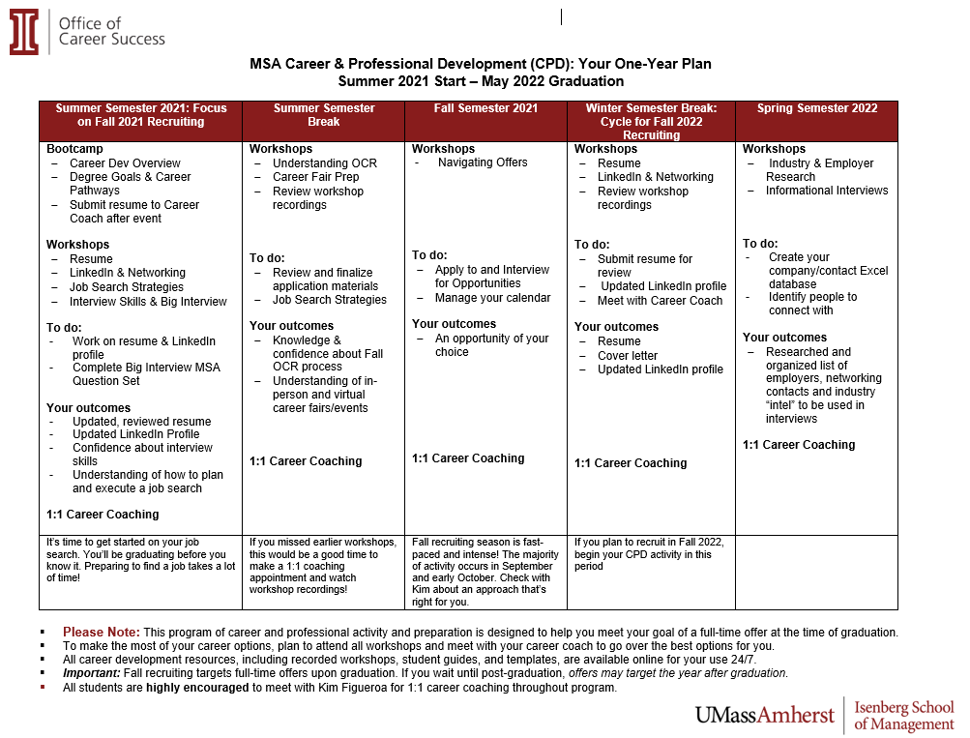

Slide 10
You had me at …..“There are so many options….”
BUT, how do I figure out what is best for me?
Research Accounting and CPA careers
Check out Blackboard Career Resources folder!
Educate Yourself about CPA Experience Requirements for Your State
Use LinkedIn to research, identify, reach out to and talk to people in jobs of interest from Isenberg and from your own undergrad institution – you may be surprised to see a number who are in the accounting profession!
Work with Career Coach on updating your LinkedIn Profile to be prepared to connect with alum and set up informational interviews
Learn about salary information for desired careers (Entry Level Audit/Tax in Public Accounting ~ 60K)
Become familiar with KEYWORDS
Found in job postings (skills, requirements), on firm career websites, in articles about careers.
KEYWORDS play an important role in application materials, LinkedIn Profiles, interview approach and preparation and in networking conversations

Slide 11
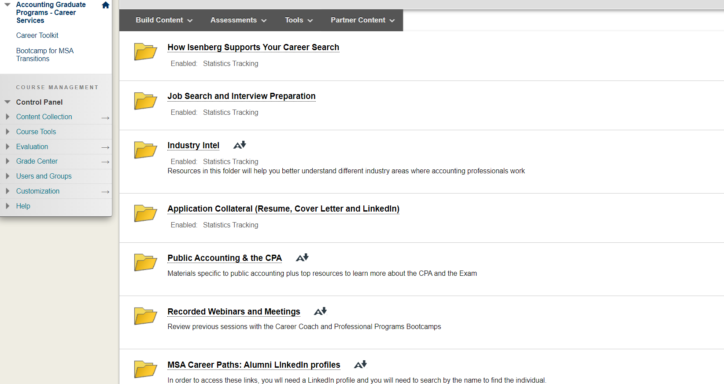
Career Resources in Blackboard

Slide 12
https://www.aicpa.org/career/careerpaths.html
#2 THEN HERE
#1 START HERE!
Click on these links, too!

Slide 13
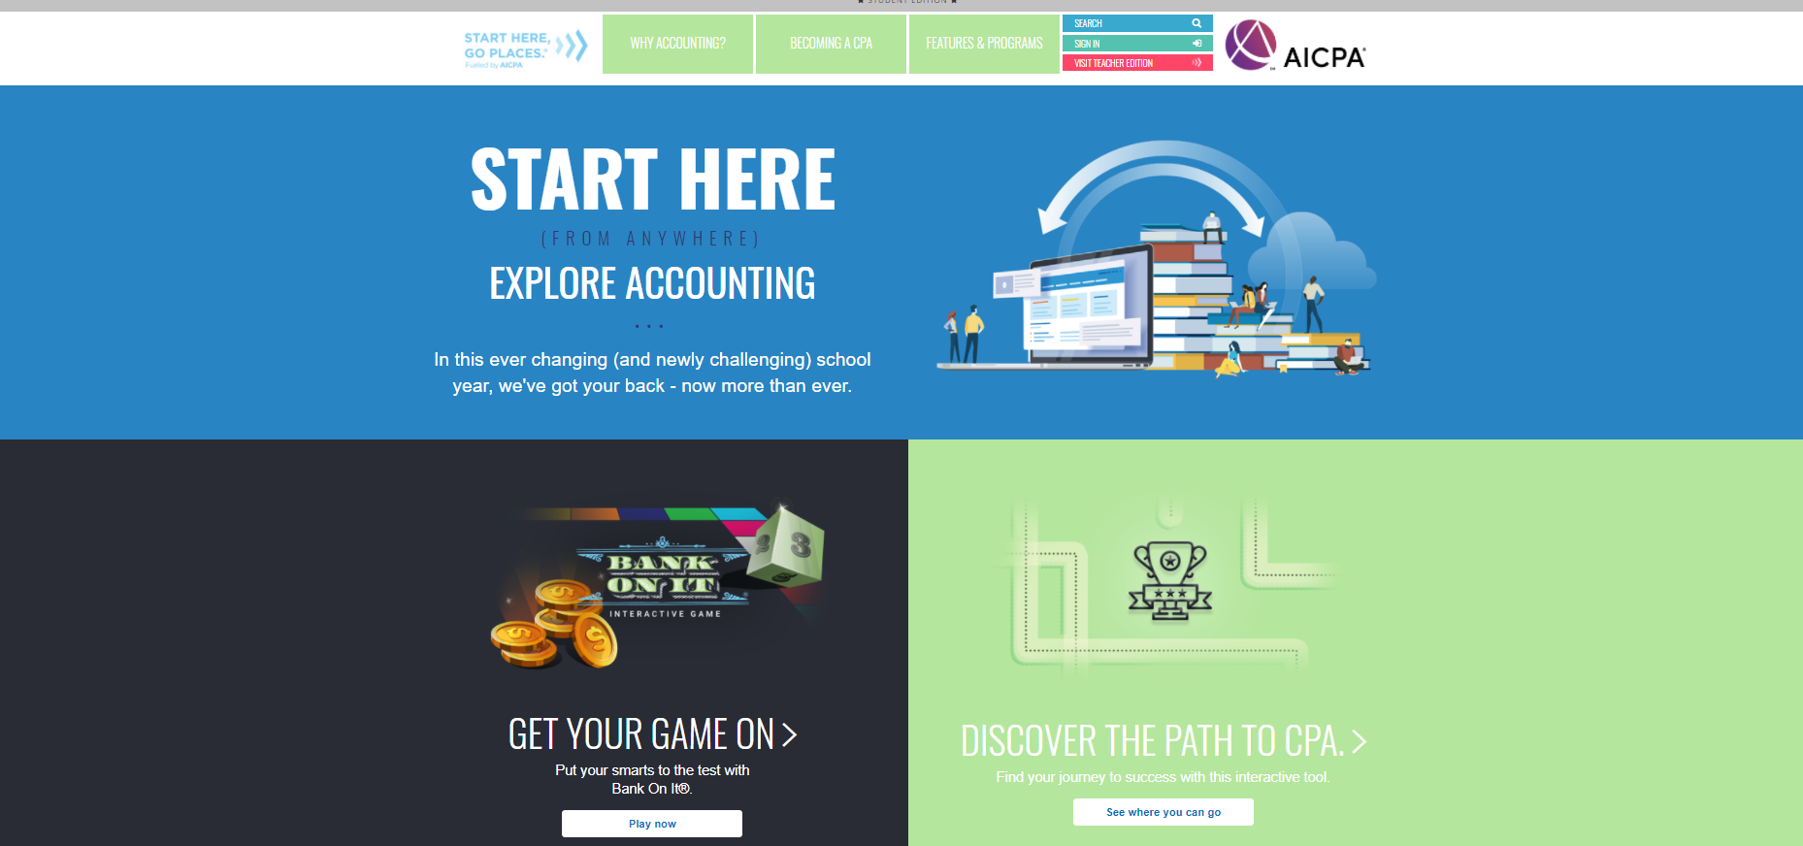
https://www.startheregoplaces.com/students/

Slide 14
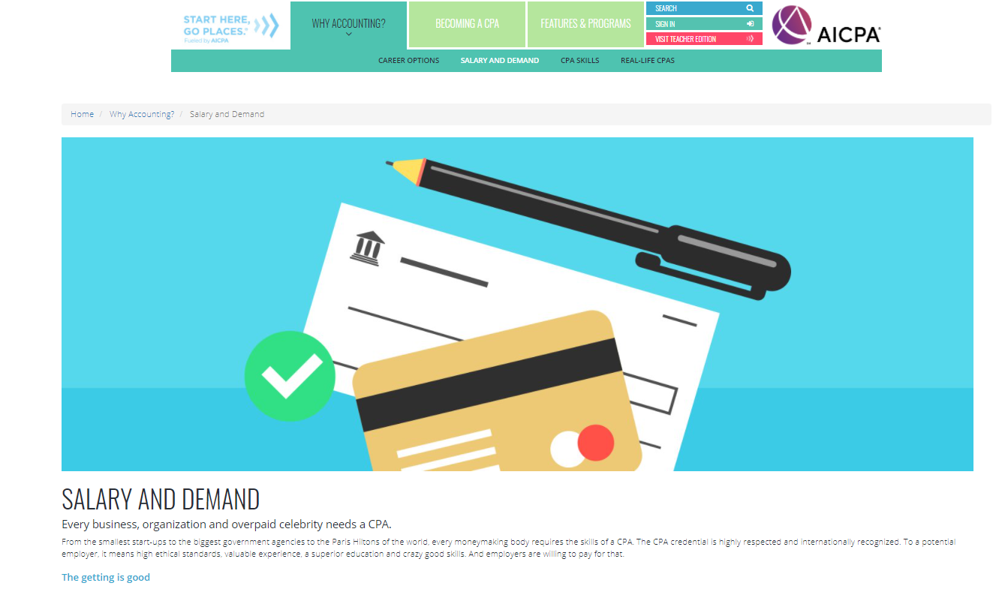
Spin the Career Futurizer Wheel….
Let Your Curiosity Be Your Guide
Identify Job titles
Use what you discover and plug keywords into other career research tools
Dig into salaries in the “Salary and Demand” section
What Will I Make$$?

Slide 15
https://www.surgent.com/blog/alternative-career-paths-for-cpas/
Featured Careers
Corporate Banking
Buy-Side Financial Analyst
FBI
Corporate Accounting/Finance
Financial Planning

Slide 16
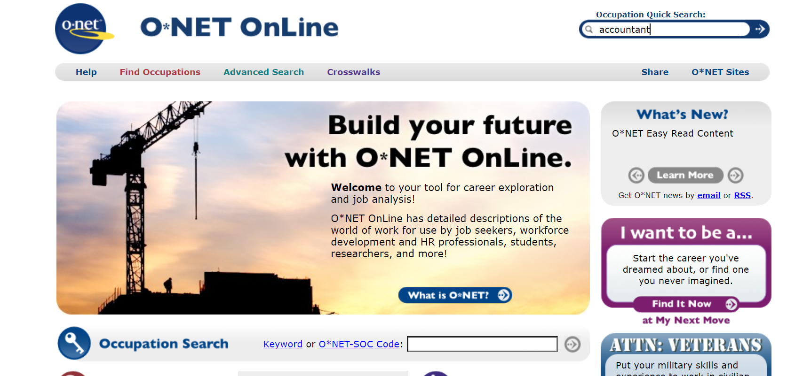
www.onetonline.org

Slide 17
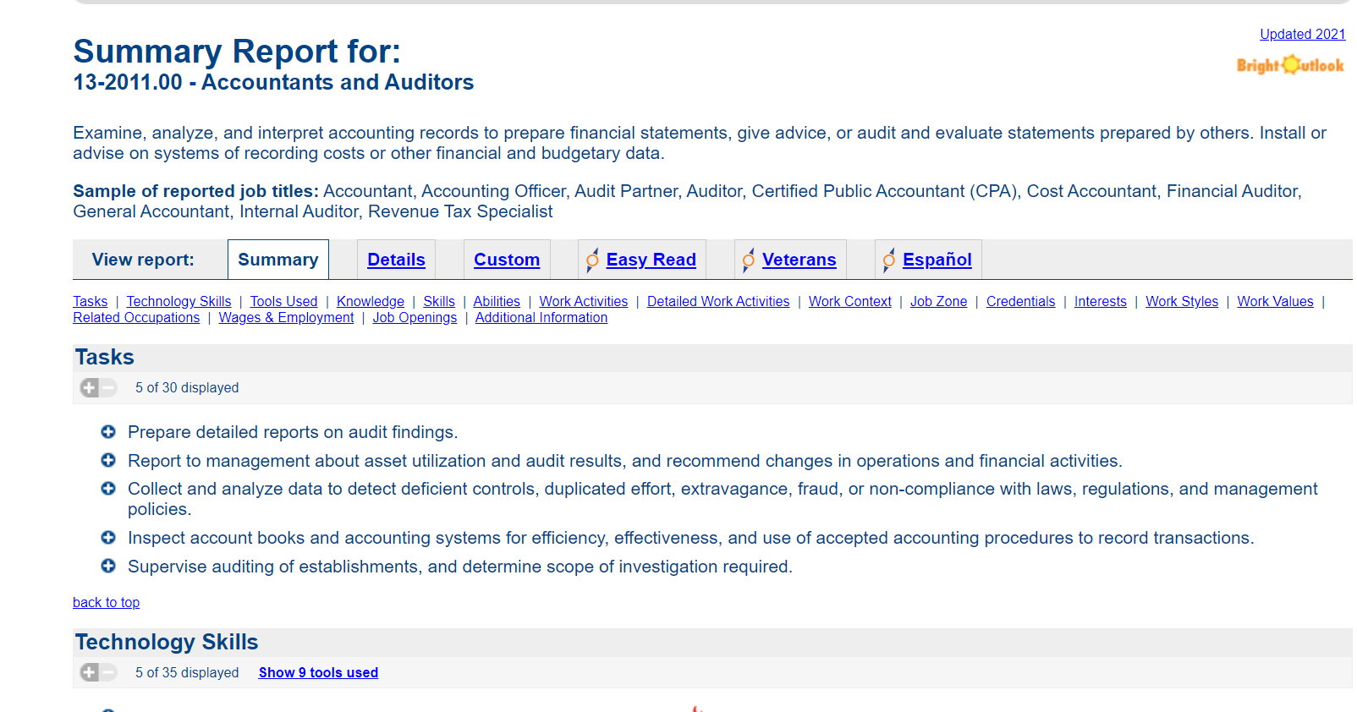
ONET Summary Report of Occupation

Slide 18
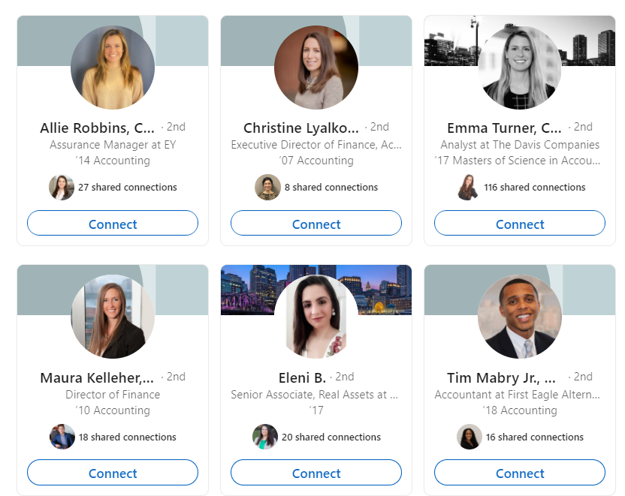
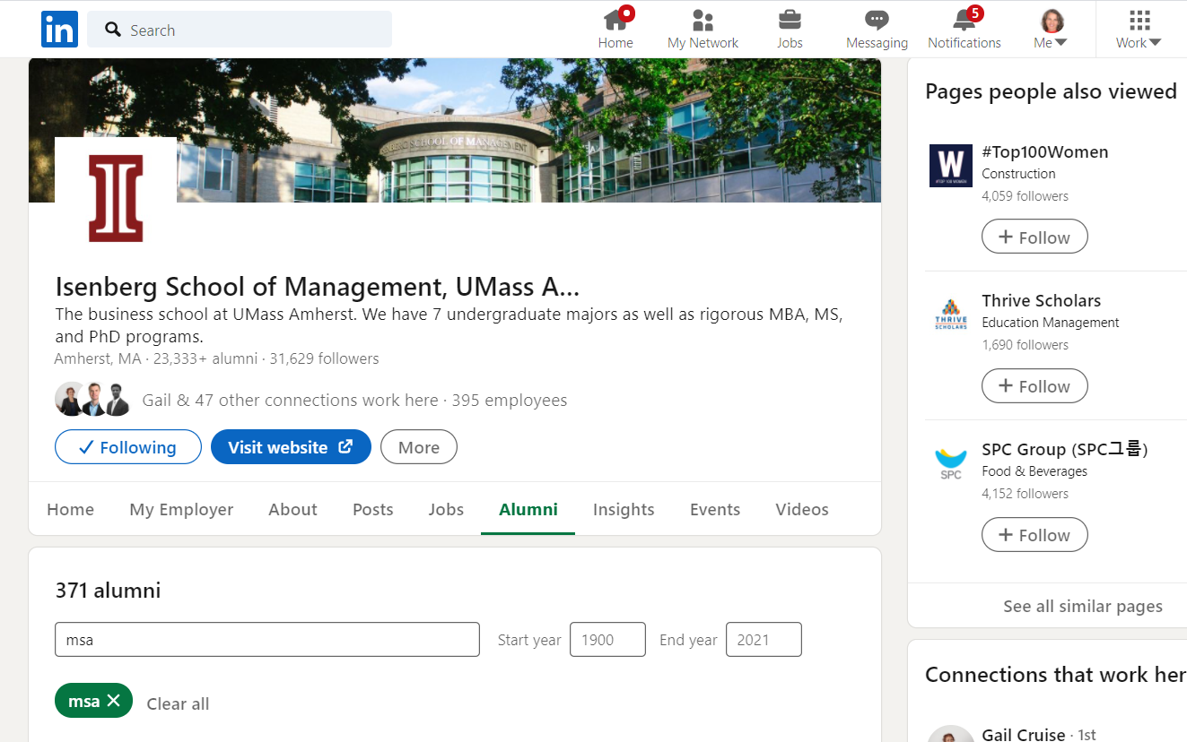
LinkedInhttps://www.linkedin.com/school/isenberg-school-of-management-umass-amherst/people/?keywords=msa

Slide 19
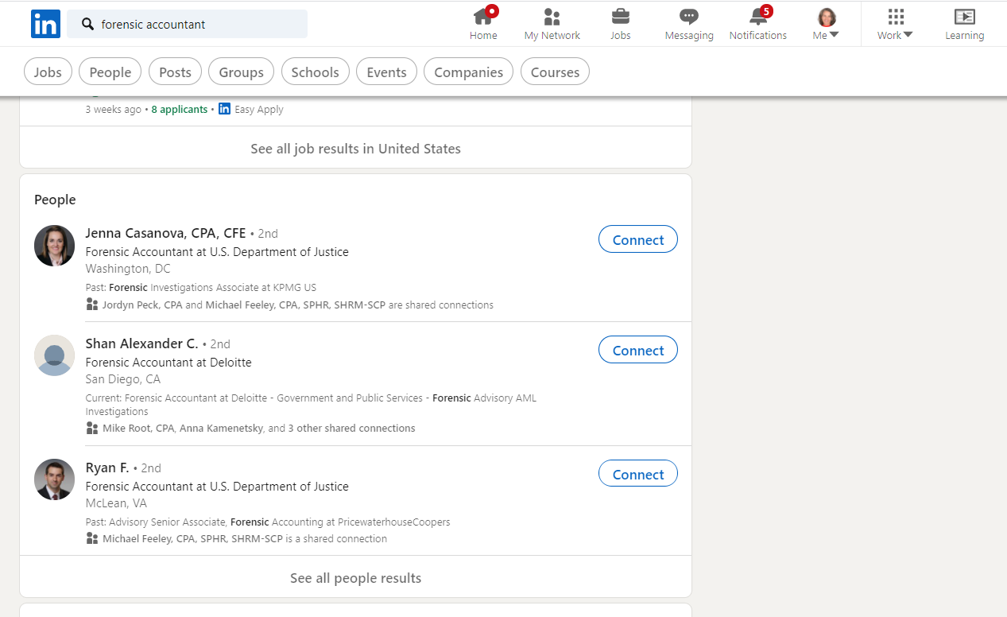
1. In the search bar, type a job title or keyword
2. Click on one of the “bubbles” to see specific content
3. Learn about people’s career progression, degrees, etc
4. Read job postings based on key words, learn about qualifications for different levels of positions

Slide 20
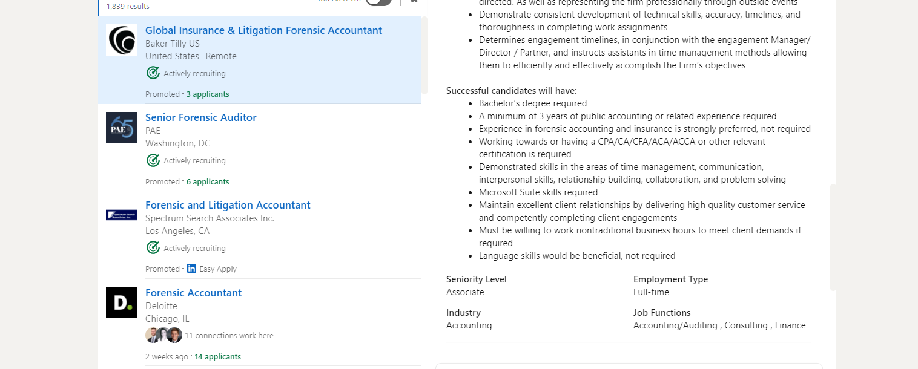
Read Job Postings for Jobs of Interest - Requirements for jobs….lots of good information!
LinkedIn.com/jobs/

Slide 21
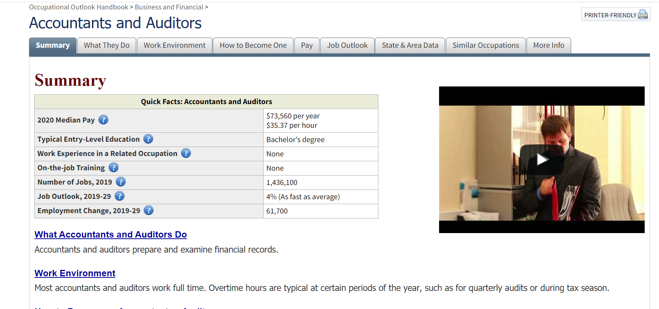
www.bls.gov (Bureau of Labor Statistics)

Slide 22
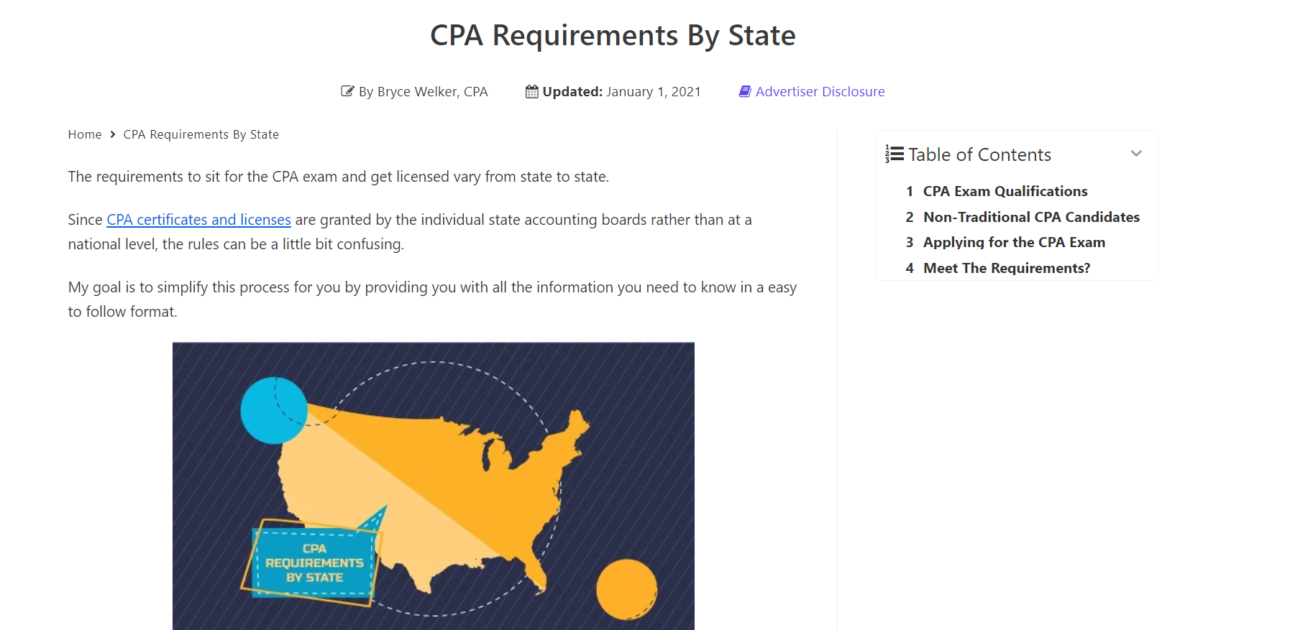
Crush the CPA Exam: https://crushthecpaexam.com/

Slide 23
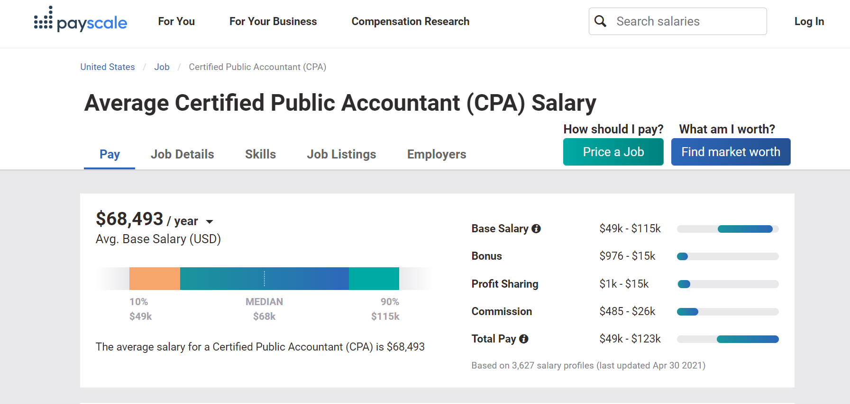
Show Me The $$$!!
Salary Resources
salary.com
Payscale.com
Bls.gov
Glassdoor.com
Salary Handout in Blackboard

Slide 24
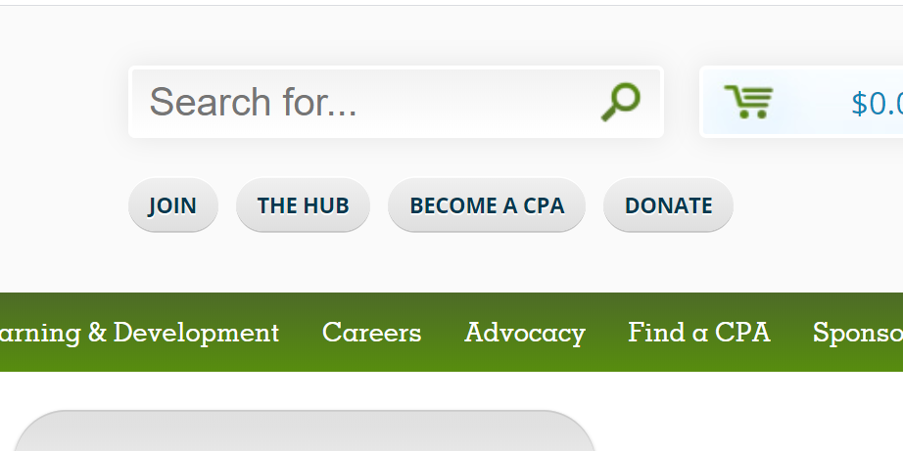
mscpaonline.org cpatrack.com
Notes:
In addition to the Firm Guide being an immediate useful resource, you may be interested in learning more about the CPA journey and if you click here on the MSCpaOnline.org website, you’ll be taken to the site, CPATrack.com.
Like membership with the Massachusetts Society, membership here is FREE for students.

Slide 25
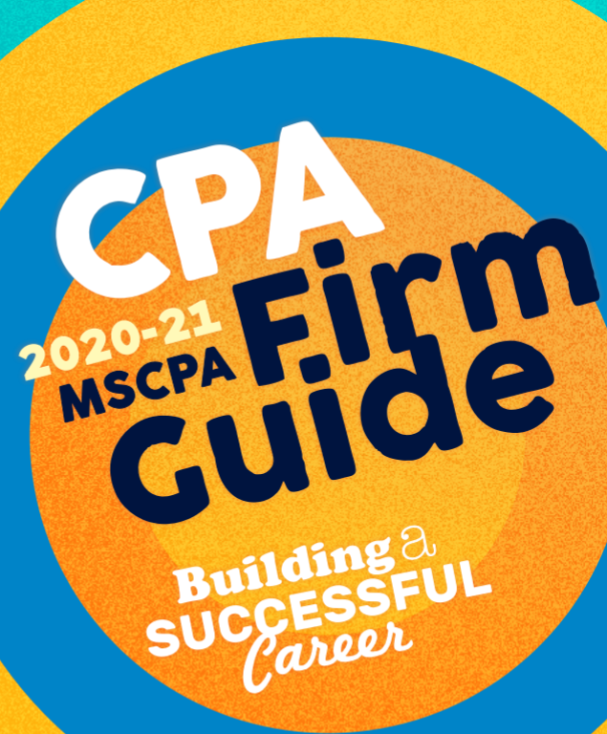
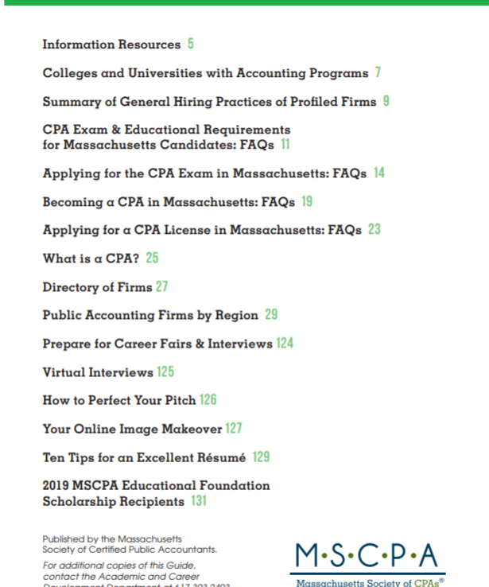
Massachusetts Society of CPAs
Notes:
If you are not already familiar with the Massachusetts Society of CPAs, it is the state's premiere professional organization with more than 11,000 members in public accounting, industry and business, government and education. In addition to a wealth of resources available on the website, the Mass Society of CPA hosts events for members for educational and networking purposes. All major firms in Massachusetts are members.
One of the organizations most helpful publications is the annual CPA Guide which is an excellent resources for researching firms, their industry specializations, size of firm and recruiting practices.
I have added a link for the Massachusetts Society of CPAs Firm Guide to Blackboard so that you can look at the guide virtually.

Slide 26
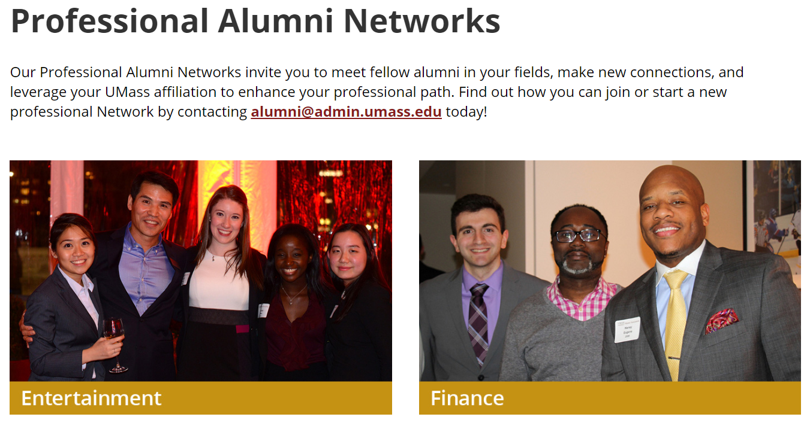
Connect UMass
Explore the Community:
Alumni Directory
Groups
Jobs
Discussion
Resources
Events
Notes:
The Jobs tab will allow students to customize their career interests and ensures information recommended by LinkedIn most closely aligns with your career preferences. Remember – LinkedIn is intuitive – the more information you can provide, the more customized the experience will be.

Slide 27
QUESTIONS?

