Slide 1
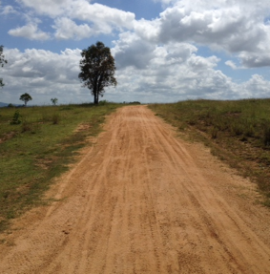
Your Cover Letter’s Story
MBA BOOTCAMP 2023

Slide 2
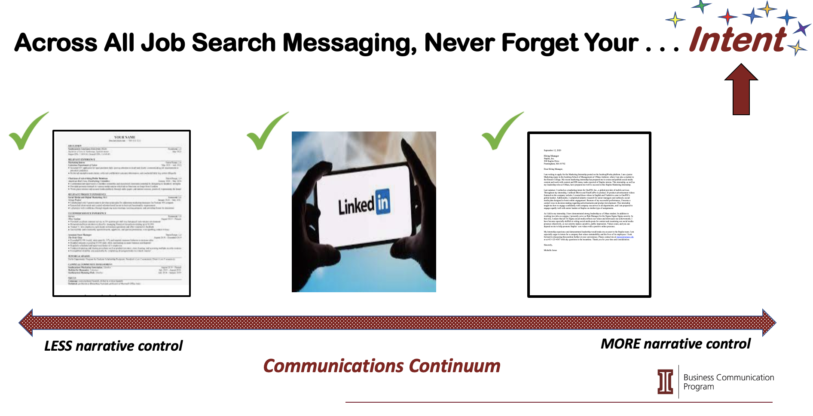

Slide 3


Slide 4
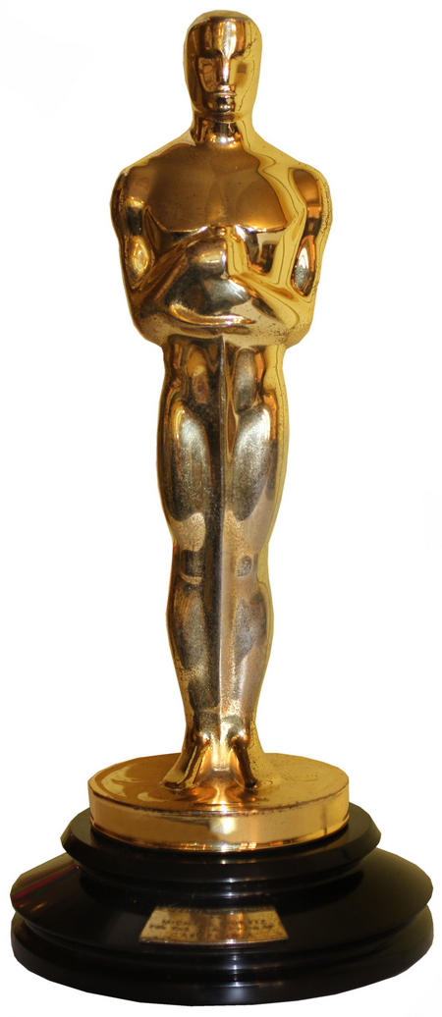


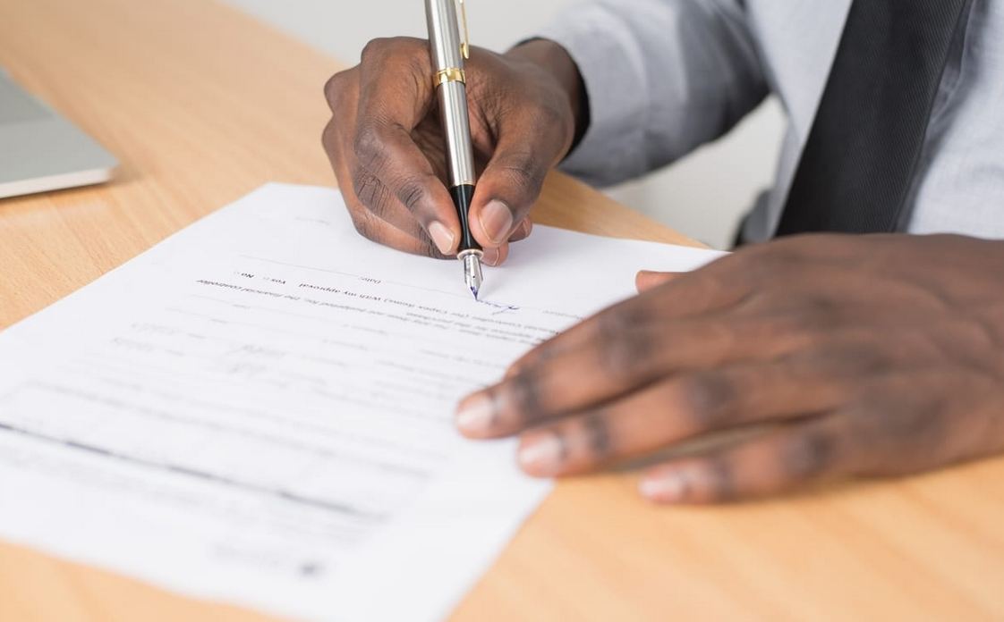
Film Trailer Film Award
Cover Letter Interview Offer

Slide 5
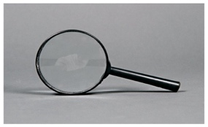
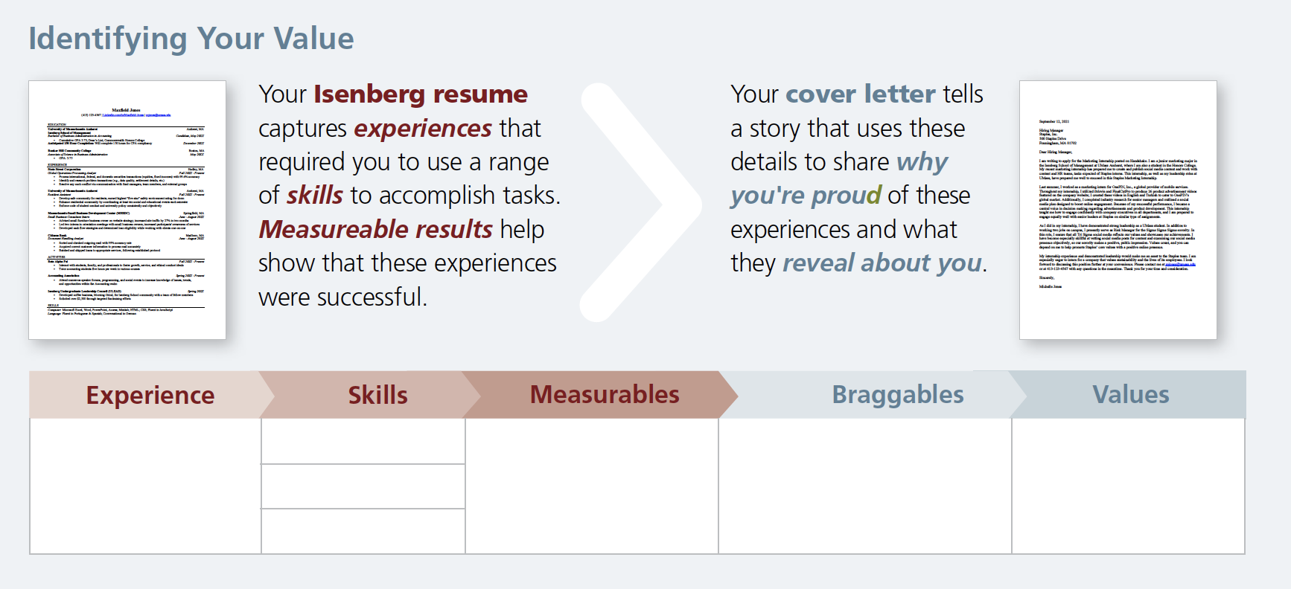
Use Your Brand To Build Your Story
Your Positioning + Your Values

Slide 6
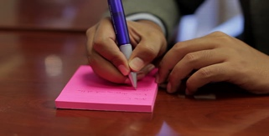
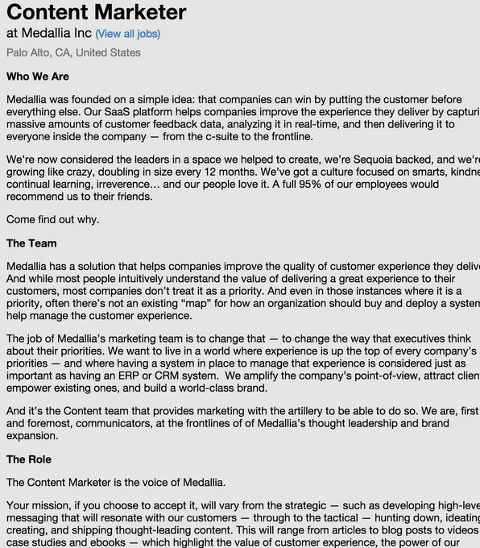
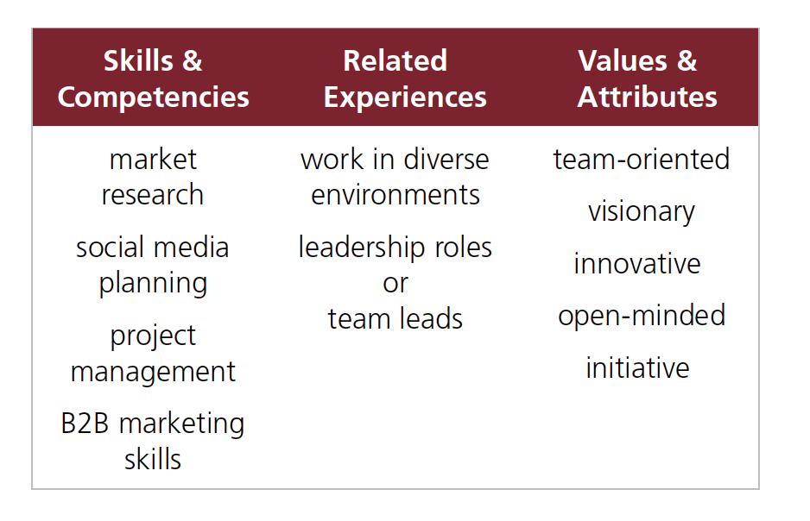
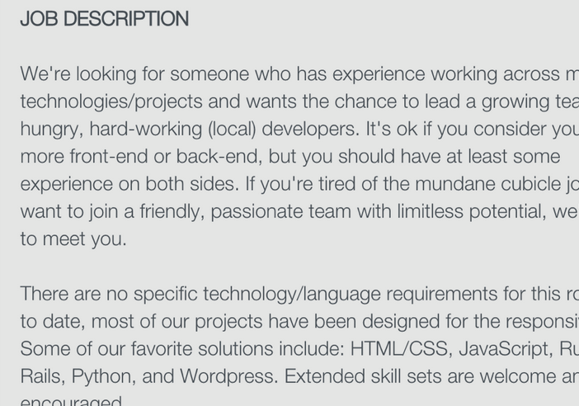
Identify Your Readers’ Needs
Your Brand + Reader’s Needs

Slide 7
Build an Argument That Aligns Your Brand with Readers’ Needs
Your Brand + Reader’s Needs

Slide 8

Build an Argument That Aligns Your Brand with Readers’ Needs
Your Brand + Reader’s Needs
“SELL” PARAGRAPH
“HOMEWORK” PARAGRAPH
What examples will I use?
How many paragraphs should I write?
S.T.A.R. PARAGRAPH

Slide 9
Build an Argument That Aligns Writer, Reader Interests
Your Brand + Reader’s Needs
“SELL” PARAGRAPH
As a Quality Assurance Engineer, I understand the challenges that defense companies like Raytheon experience with suppliers. Specifically, I have conducted and requested various root cause analyses and corrective actions, both as a supplier and customer. I also know how to evaluate technical design documents and—importantly—give relevant, meaningful feedback to product development teams. My MBA has given me the confidence to lead Raytheon production teams in a challenging market, and you can expect me to inspire results that uphold your industry-leading standards.

Slide 10
Build an Argument That Aligns Writer, Reader Interests
Your Brand + Reader’s Needs
S.T.A.R. PARAGRAPH
Establish the Situation (e.g., role, background) for your example;
Describe the Task or problem you addressed in a specific situation;
Explain the Action you took to manage the task or problem successfully;
Discuss the Result of your action and value you added.
I take on challenges that my colleagues dismiss as impossible to fix. Most recently, as the newest member of a systems support team, I managed to bring together disparate viewpoints on a team especially rife with internal conflict. Specifically, I suggested a new format for weekly team status meetings: a range of 360 feedback tools to help us recognize that we shared more commonalities than differences with respect to IT systems-based challenges. As a result of our improved communication, our team’s productivity improved by 36% over the prior six months, and we even received our division’s highly-sought “Most Improved Team” award. I am especially proud of my proven ability to transform team dynamics, and I share Logistics’ core belief that team-based innovation drives success.

Slide 11
Build an Argument That Aligns Writer, Reader Interests
Your Brand + Reader’s Needs
“HOMEWORK” PARAGRAPH
”I know who you are; I share those values.”
Sustainability
Corporate Social Responsibility
Corporate Mission & Vision
Today, sustainability motivates my generation, and I am no exception. I feel compelled to make a positive impact in my lifetime building more resilient, sustainable food systems and tackling the plastics crisis. Hormel’s commitment to shrinking its environmental impact and “winning with purpose” speaks to me highly. As you lead the transition away from single-use plastic, I hope to support this critical mission.

Slide 12
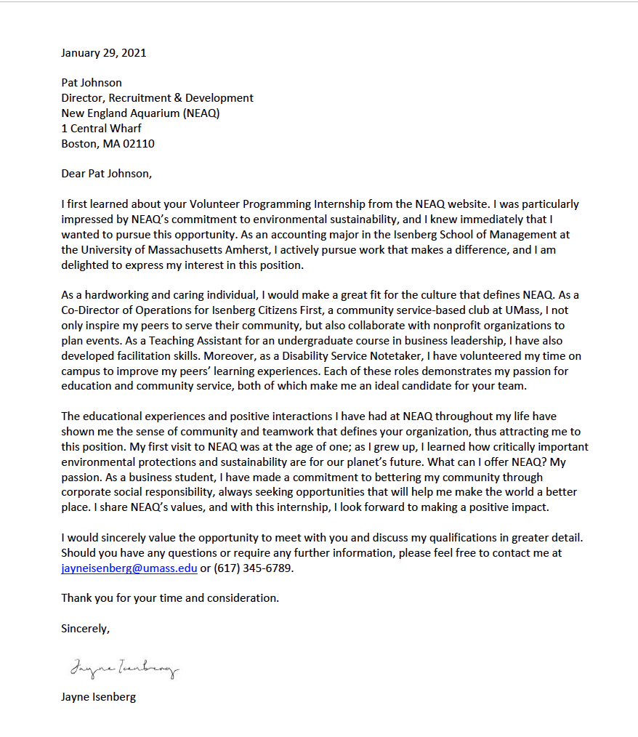
A well-written cover letter won’t land you a job, but will—and should—encourage readers to contact you for next steps.

Slide 13

Follow a Format that Meets Industry Standards
Global Arrangement + Presentation
The context (introduction) should:
  Establish the situation
  Confirm purpose for writing
  Forecast story you’ll tell
I recently spoke with Joanna Smith at the Virtual MBA Career Fair last week at the University of Massachusetts Amherst’s Isenberg School of Management, and I was excited to hear about Unilever’s need for financial analysts with demonstrated success in the field. I am writing to express my interest in the Senior Financial Analyst position (Req. ID R-05072), as I believe I possess the ideal mix of experience and leadership that would
help Unilever achieve its future goals.

Slide 14
Follow a Format that Meets Industry Standards
Global Arrangement + Presentation
The context (introduction) should:
  Establish the situation
  Confirm purpose for writing
  Forecast story you’ll tell
I recently spoke with Joanna Smith at the Virtual MBA Career Fair last week at the University of Massachusetts Amherst’s Isenberg School of Management, and I was excited to hear about Unilever’s need for financial analysts with demonstrated success in the field. I am writing to express my interest in the Senior Financial Analyst position (Req. ID R-05072), as I believe I possess the ideal mix of experience and leadership that would
help Unilever achieve its future goals.

Slide 15
Follow a Format that Meets Industry Standards
Global Arrangement + Presentation
The context (introduction) should:
  Establish the situation
  Confirm purpose for writing
  Forecast story you’ll tell
I recently spoke with Joanna Smith at the Virtual MBA Career Fair last week at the University of Massachusetts Amherst’s Isenberg School of Management, and I was excited to hear about Unilever’s need for financial analysts with demonstrated success in the field. I am writing to express my interest in the Senior Financial Analyst position (Req. ID R-05072), as I believe I possess the ideal mix of experience and leadership that would
help Unilever achieve its future goals.

Slide 16
Follow a Format that Meets Industry Standards
Global Arrangement + Presentation
The context (introduction) should:
  Establish the situation
  Confirm purpose for writing
  Forecast story you’ll tell
I recently spoke with Joanna Smith at the Virtual MBA Career Fair last week at the University of Massachusetts Amherst’s Isenberg School of Management, and I was excited to hear about Unilever’s need for financial analysts with demonstrated success in the field. I am writing to express my interest in the Senior Financial Analyst position (Req. ID R-05072), as I believe I possess the ideal mix of experience and leadership that would
help Unilever achieve its future goals.

Slide 17
Follow a Format that Meets Industry Standards
Global Arrangement + Presentation
The close should:
  End with goodwill, “final look”
  Confirm future action
  Anticipate questions
Thank you for considering me for this financial analyst position. I am eager to discuss how I may join Unilever to make sustainable living commonplace. In the meantime, if I can answer any additional questions, please feel free to contact me at 123-456-7890 or email@isenberg.umass.edu.

Slide 18
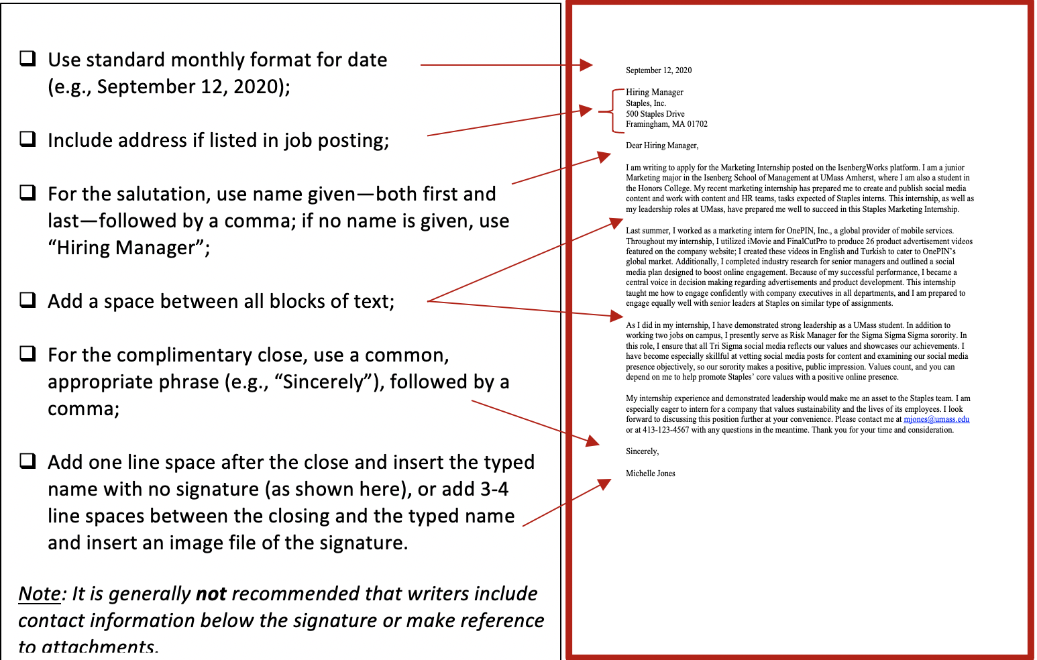
Follow a Format that Meets Industry Standards
Global Arrangement + Presentation

Slide 20
“You may do this, I tell you,
it is permitted. Begin again the story of your life.”
~Jane Hirshfield

Slide 21
Your Cover Letter’s Story
MBA BOOTCAMP 2023

